Slide 1
CSE477
VLSI Digital Circuits
Fall 2002
Lecture 05: IC Manufacturing
Mary Jane Irwin ( www.cse.psu.edu/~mji ) www.cse.psu.edu/~cg477
[Adapted from Rabaey’s Digital Integrated Circuits, ©2002, J. Rabaey et al.]
Notes:
Do seating chart.
Collect HW#1
Reminder that project titles are due next class.
Handout
HW#2

Slide 2
Review: CMOS Inverter
Full rail-to-rail swing ⇒ high noise margins
Low output impedance
High input impedance
No direct path steady-state between power and ground ⇒ no static power dissipation
Propagation delay a function of load capacitance and on resistance of transistors
V_{DD}
V_{in}
V_{out}
C_{L}
Notes:
Decreasing the on-resistance achieved by increasing the W/L ratio of the device

Slide 3
The Manufacturing Process
For a great tour (that doesn’t work anymore!!!) through the IC manufacturing process and its different steps, check out
http://www.fullman.com/semiconductors/semiconductors.html
Notes:
No longer works! (Fall 2002)

Slide 4
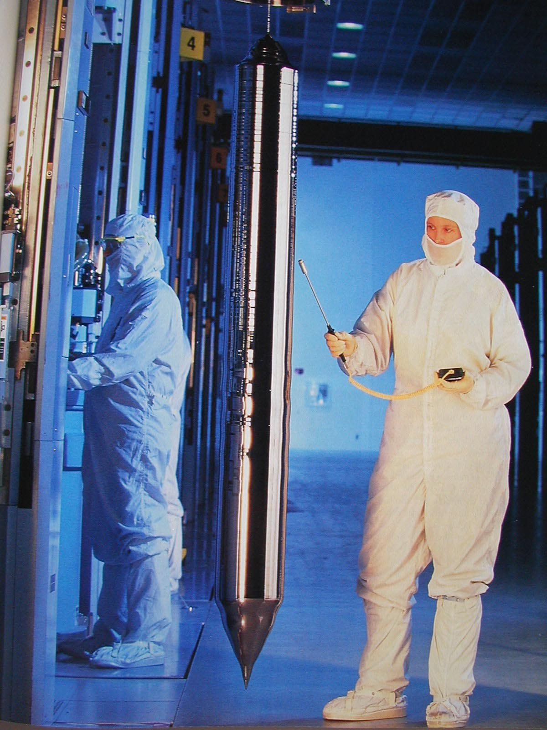
Growing the Silicon Ingot
From Smithsonian, 2000
Notes:
Base material is a single-crystalline, lightly doped wafer between 4 and 12 inches and a thickness of, at most, 1 mm – obtained from cutting a single-crystal ingot into thin slices. Starting wafer of p- type around 2 x 10**21 impurities/m**3.
The surface is then doped more heavily with a single crystal epitaxial layer grown over the surface before the wafer goes to the processing company.
Important metric – defect density

Slide 5
CMOS Process at a Glance
Define active areas
Etch and fill trenches
One full photolithography sequence per layer (mask)
Built (roughly) from the bottom up
  5 metal 2
  4 metal 1
  2 polysilicon
  3 source and drain diffusions
  1 tubs (aka wells, active areas)
Implant well regions
Deposit and pattern
polysilicon layer
Implant source and drain
exception!
regions and substrate contacts
Create contact and via windows
Deposit and pattern metal layers

Slide 6
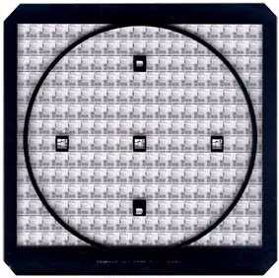
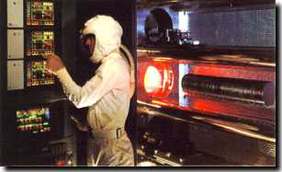
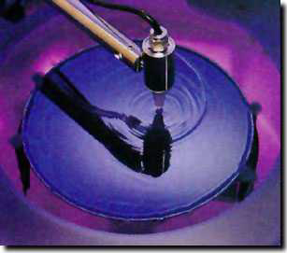
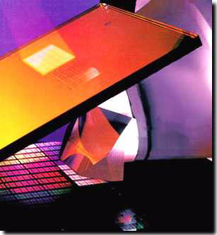
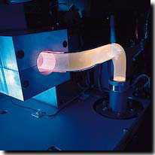
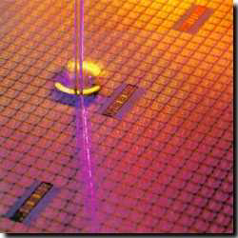
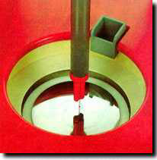
Photolithographic Process
optical mask
oxidation
stepper exposure
photoresist removal (ashing)
photoresist coating
photoresist development
process
step
spin, rinse, dry
acid etch

Slide 7
Patterning - Photolithography
Oxidation
Photoresist (PR) coating
Stepper exposure
Photoresist development and bake
Acid etching Unexposed (negative PR) Exposed (positive PR)
Spin, rinse, and dry
Processing step Ion implantation Plasma etching Metal deposition
Photoresist removal (ashing)
UV light
mask
SiO₂
PR
Notes:
Same sequence patterns the complete surface of the wafer. Hence it is a very parallel process transferring hundreds of millions of patterns to the wafer surface simultaneously making cheap manufacturing of complex circuits possible.
1 – deposit thin layer of SiO2 by exposing it to a mixture of high-purity oxygen and hydrogen at 1000C
2 – light-sensitive polymer evenly applied while spinning the wafer to a thickness of 1 micron; polymers cross-link when exposed to light making the affected region insoluble (negative PR) or original insoluable, soluable after exposure (positive PR). COST OF MASKS IS INCREASING QUITE RAPIDLY WITH SCALING OF TECHNOLOGY – A REDUCTION OF MASKS IS OF HIGH PRIORITY!
3 – glass mask containing patter brought in close proximity to the wafer. Mask is transparent in regions we want to process and opaque elsewhere (positive PR). Combination exposed to UV light. Where mask is transparent, photoresist becomes soluable. Dimensions of features is approaching the wavelength of optical light sources (we’re good up to 0.1 micron). Will eventually move to X-ray or electron-beam (much less cost effective).
4 – Exposed photoresist is removed in a acid or base wash, then wafer is “soft-baked” to harden remaining PR
5 – Exposed material (SiO2) is removed via acid, base, and caustic solution wash.
6 – SRD – number of dust particles per cubic foot of air in clean room ranges between 1 and 10
8 – high-temperature plasma is used to selectively remove the remaining photoresist

Slide 8
Example of Patterning of SiO2
Chemical or plasma
etch
Hardened resist
Si-substrate
SiO
2
Si-substrate
Silicon base material
4. After development and etching of resist, chemical or plasma etch of SiO₂
Photoresist
SiO₂
Si-substrate
1&2. After oxidation and deposition of negative photoresist
Hardened resist
SiO₂
Si-substrate
UV-light
5. After etching
Patterned
optical mask
Exposed resist
SiO₂
Si-substrate
Si-substrate
3. Stepper exposure
8. Final result after removal of resist

Slide 9
Diffusion and Ion Implantation
Area to be doped is exposed (photolithography)
Diffusion
or
Ion implantation
Notes:
Needed for well, source and drain regions, doping of polysilicon, adjustment of thresholds
Diffusion – wafer placed in quartz tube embedded in a furnace (900 to 1100 C). Gas containing dopant is introduced in the tub. Dopands diffused into the exposed surface both vertically and horizontally. Final dopant concentration is highest at surface and decreases in a gaussian profile deeper in the material
Ion implantation – Dopants are introduced as ions into the material by sweeping a beam of purified ions over the surface - acceleration determines how deep ions will penetrate and the beam current and exposure time determine dosage. Independent control of depth and dosage – ion implantation has largely displaced diffusion. However, has a side effect of causing lattice damage to substrate, so usually follow with an annealing step (wafer heated to 1000C for 15 to 30 minutes and allowed to cool slowly). Heating vibrates atoms and allows the bonds to reform.

Slide 10
Deposition and Etching
Pattern masking (photolithography)
Deposit material over entire wafer CVD (Si₃N₄) chemical deposition (polysilicon) sputtering (Al)
Etch away unwanted material wet etching dry (plasma) etching
Notes:
Needed for insulating SiO2, silicon nitride (sacrificial buffer), polysilicon, metal interconnect
CVD – chemical vapor deposition uses a gas-phase reaction with energy supplied by heat at around 850C. Use for, eg, silicon nitride
Chemical deposition – used for polysilicon. flow silane gas over the heated wafer (coated with SiO2) at approx. 650C. Resulting reaction produces a non-crystaline material – polysilicon. Followed by an implant step to increase its conductivity.
Sputtering – used for aluminum. Al evaporated in a vacuum, heat for evaporation delivered by e-bam bombarding.
Etching is then used to selectively form patterns (wires, contact holes). Wet etching using acid or basic solutions – hydrofluoric acid buffered with fluoride is used to etch SiO2. Plasma etching becoming more common. Use plasma molecules in heated chamber to “sandblast” the surface. Gives well-defined directionality to the etching action, creating patterns with sharp vertical contours.

Slide 11
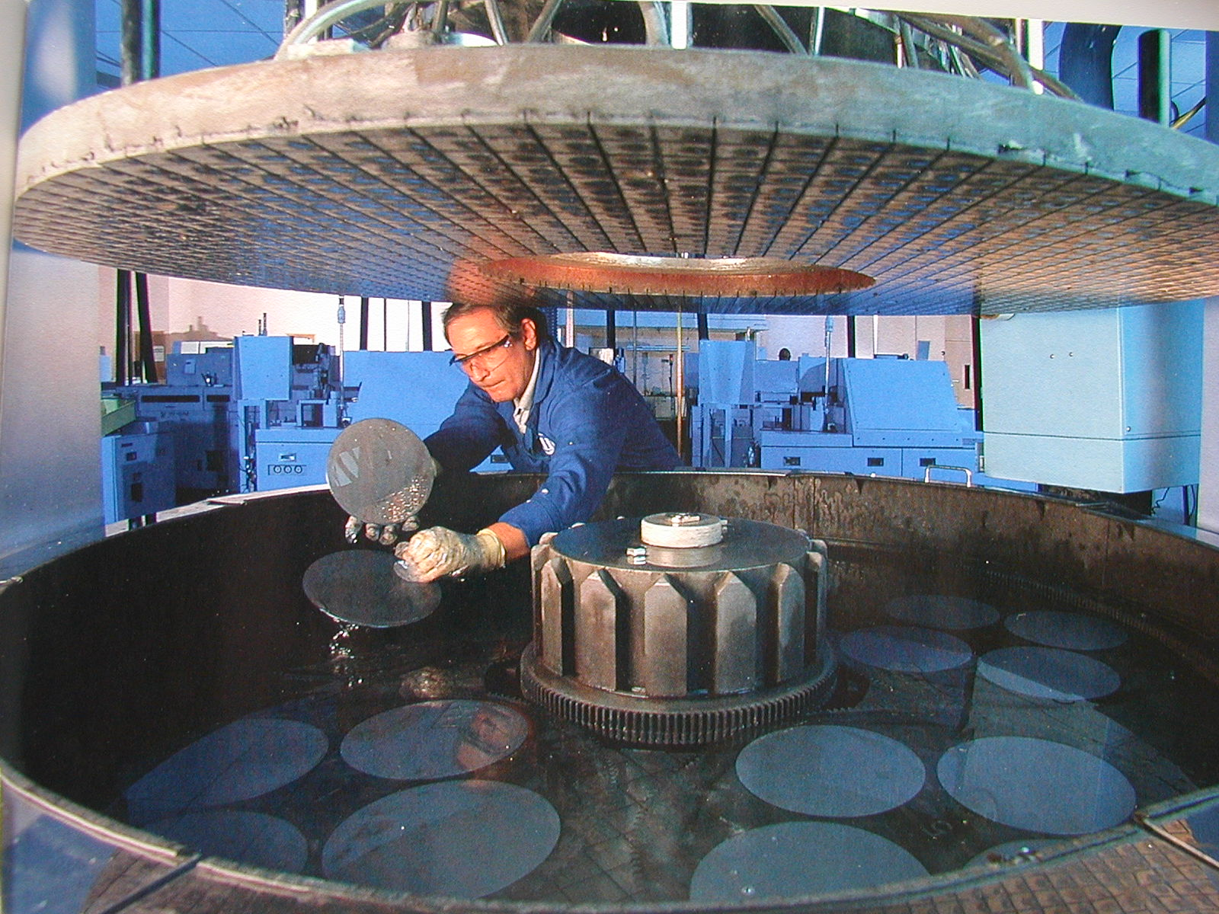
Planarization: Polishing the Wafers
From Smithsonian, 2000
Notes:
Essential to keep the surface of the wafer approximately flat between processing steps.
Chemical-mechanical planarization (CMP) step is included before the deposition of an extra metal layer on top of SiO2. The process uses a slurry compound – a liquid carrier with a suspended abrasive component such as aluminum oxide or silica – to microscopicall plane a device layer and to reduce step heights.

Slide 12
Self-Aligned Gates
Create thin oxide in the “active” regions, thick elsewhere
Deposit polysilicon
Etch thin oxide from active region (poly acts as a mask for the diffusion)
Implant dopant
Notes:
Polysilicon gate is patterned before source and drain are created – thereby actually defining the precise location of the channel region and the locations of the source and drain regions. This allows for very precise positioning of the source and drain relative to the gate.
Note that can’t completely stop lateral diffusion – accounts for difference between drawn transistor dimensions and actual ones

Slide 13
Simplified CMOS Inverter Process
cut line
p well
Notes:
n type substrate - p well/tub

Slide 14
P-Well Mask
Notes:
After p-well use implants to adjust VTn

Slide 15
Active Mask
Notes:
Grown thick oxide. Then use active mask to create thin oxide layers over the active areas – where we are going to place the transistors (source, gate, and drain areas)

Slide 16
Poly Mask
Notes:
First used chemical deposition to deposit polysilicon on wafer.
Note thin oxide area for gate oxide - critical (helps determine Vth) doe 0.25 micron technology -> 6.5 to 5.5 microns thick

Slide 17
P+ Select Mask
Notes:
Followed by diffusion (ion implant) to build pfets source and drain areas

Slide 18
N+ Select Mask
Notes:
Followed by diffusion (ion implant) to build nfets source and drain areas

Slide 19
Contact Mask
Notes:
After deposition of SiO2 insulator, then contact holes are etched (in this case to make contacts to source and drain regions)

Slide 20
Metal Mask
Notes:
62 processing steps for a double/twin tub CMOS process!!
tanqueray.eecs.berkeley.edu/~ehab/inv.html

Slide 21
A Modern CMOS Process
Dual-Well Trench-Isolated CMOS
gate oxide
field oxide
Al (Cu)
SiO₂
TiSi₂
tungsten
p well
n well
SiO₂
p-epi
n+
p+
p-
Notes:
dual-well approach uses both n- and p- wells grown on top of a epitaxial layer(using trench isolation areas of SiO2)

Slide 22
Modern CMOS Process Walk-Through
p-epi
Base material: p+ substrate with p-epi layer
p
+
Si
N
3
4
p-epi
SiO
2
After deposition of gate-oxide and sacrifical nitride (acts as a buffer layer)
p
+
After plasma etch of insulating trenches using the inverse of the active area mask
p
+
Notes:
These would be best to convert to color – but I don’t have the energy!!

Slide 23
CMOS Process Walk-Through, con’t
SiO
After trench filling, CMP planarization, and removal of sacrificial nitride
2
n
After n-well and V_{Tp} adjust implants
p
After p-well and V_{Tn} adjust implants

Slide 24
CMOS Process Walk-Through, con’t
poly(silicon)
After polysilicon deposition and etch
n
+
p
+
After n+ source/dram and p+ source/drain implants. These steps also dope the polysilicon.
SiO
2
After deposition of SiO₂ insulator and contact hole etch

Slide 25
CMOS Process Walk-Through, con’t
Al
After deposition and patterning of first Al layer.
Al
SiO
2
After deposition of SiO₂ insulator, etching of via’s, deposition and patterning of second layer of Al.

Slide 26
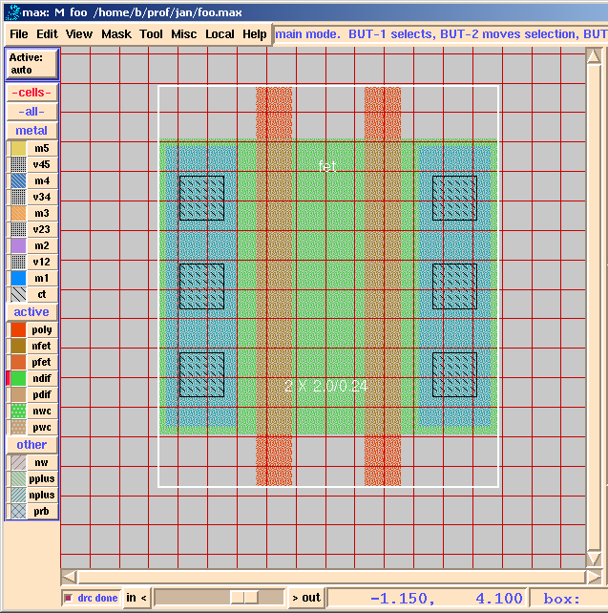
Layout Editor: max Design Frame

Slide 27
max Layer Representation
Metals (five) and vias/contacts between the interconnect levels
  Note that m5 connects only to m4, m4 only to m3, etc., and m1 only to poly, ndif, and pdif
  Some technologies support “stacked vias”
Active – active areas on/in substrate (poly gates, transistor channels (nfet, pfet), source and drain diffusions (ndif, pdif), and well contacts (nwc, pwc))
Wells (nw) and other select areas (pplus, nplus, prb)
Notes:
contacts form interconnections between metal and active or poly
vias form interconnections between two metal layers

Slide 28
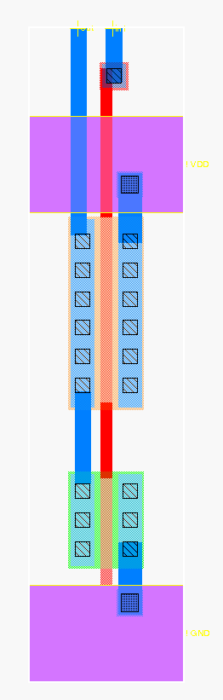
CMOS Inverter max Layout
Out
In
metal1-poly via
metal1
polysilicon
metal2
V_{DD}
pfet
PMOS (4/.24 = 16/1)
pdif
NMOS (2/.24 = 8/1)
metal1-diff via
ndif
nfet
GND
metal2-metal1 via

Slide 29
Simplified Layouts in max
Online design rule checking (DRC)
Automatic fet generation (just overlap poly and diffusion and it creates a transistor)
Simplified via/contact generation
  v12, v23, v34, v45
  ct, nwc, pwc
0.44 x 0.44 m1
0.3 x 0.3 ct
0.44 x 0.44 poly

Slide 30
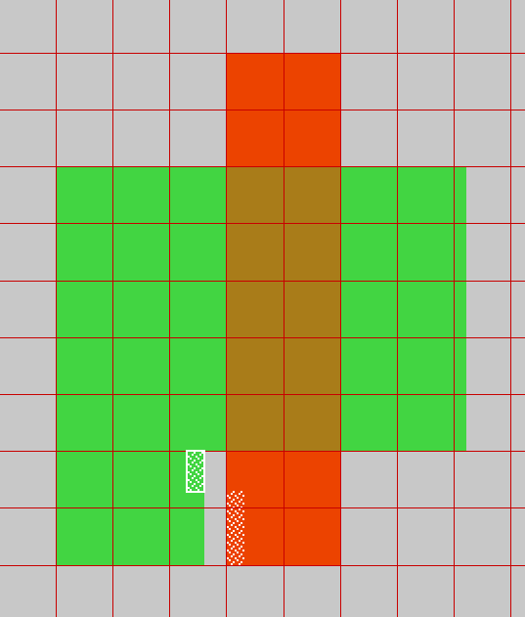
Design Rule Checker
poly_not_fet to all_diff minimum spacing = 0.14 um

Slide 31
Design Rules
Interface between the circuit designer and process engineer
Guidelines for constructing process masks
Unit dimension: minimum line width
  scalable design rules: lambda parameter
  absolute dimensions: micron rules
Rules constructed to ensure that design works even when small fab errors (within some tolerance) occur
A complete set includes
  set of layers
  intra-layer: relations between objects in the same layer
  inter-layer: relations between objects on different layers

Slide 32
Why Have Design Rules?
To be able to tolerate some level of fabrication errors such as
Mask misalignment
Dust
Process parameters (e.g., lateral diffusion)
Rough surfaces
Notes:
Motivation for design rules – next slide

Slide 33
Intra-Layer Design Rule Origins
Minimum dimensions (e.g., widths) of objects on each layer to maintain that object after fab
  minimum line width is set by the resolution of the patterning process (photolithography)
Minimum spaces between objects (that are not related) on the same layer to ensure they will not short after fab
0.3 micron
0.15
0.3 micron
0.15
Notes:
why would the spacing of the active (n) area be different that drawn? - due to lateral diffusion

Slide 34
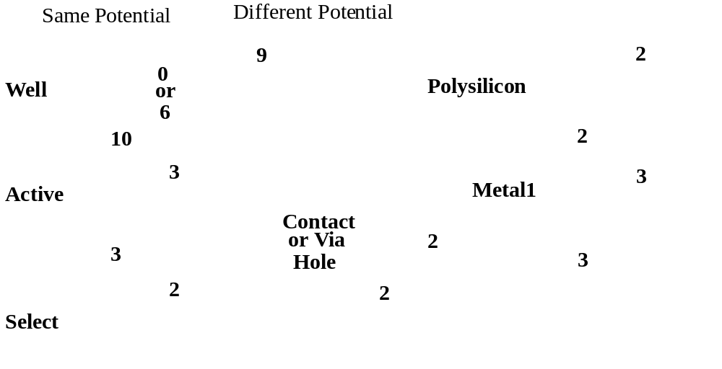
Intra-Layer Design Rules
4
Metal2
3

Slide 35
Inter-Layer Design Rule Origins
Transistor rules – transistor formed by overlap of active and poly layers
Transistors
Catastrophic error
Unrelated Poly & Diffusion
Thinner diffusion,
but still working

Slide 36
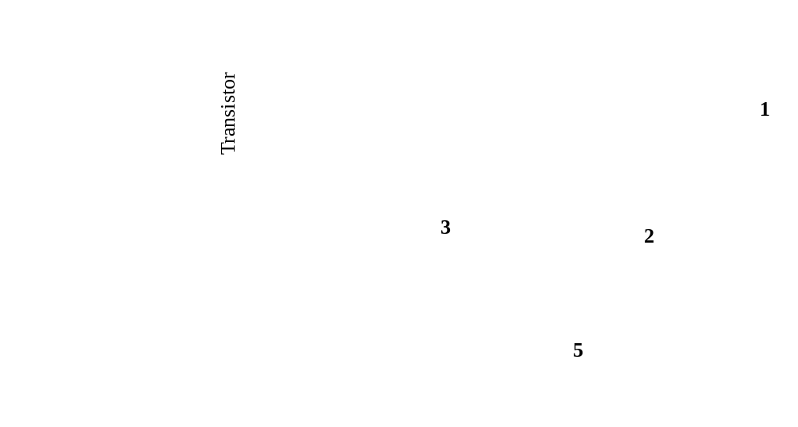
Transistor Layout

Slide 37
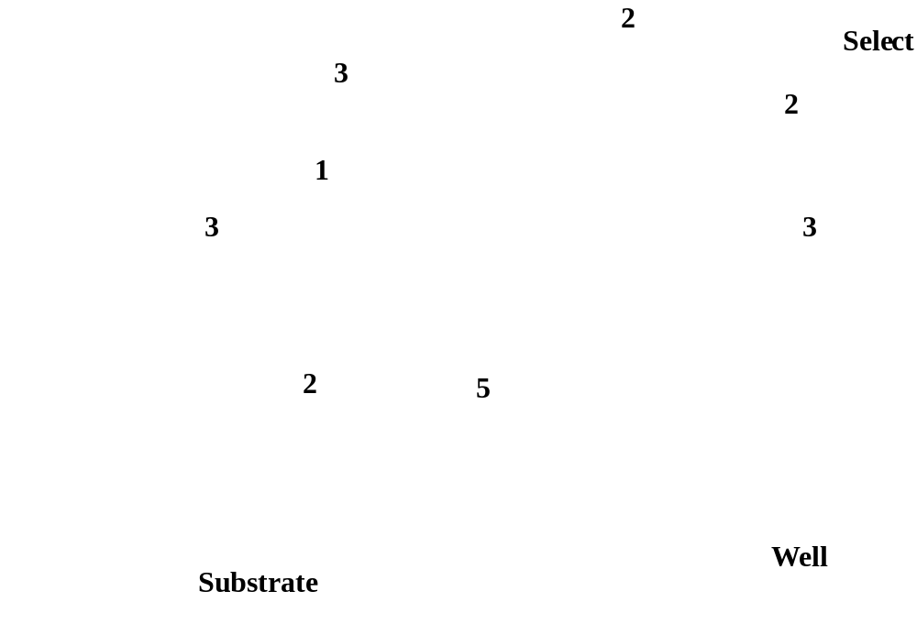
Select Layer

Slide 38
Inter-Layer Design Rule Origins, Con’t
Contact and via rules
M1 contact to p-diffusion
M1 contact to n-diffusion
Contact Mask
M1 contact to poly
Mx contact to My
Via Masks
0.3
mask misaligned
both materials
Contact: 0.44 x 0.44
0.14
Notes:
Note that the minimum area of a contact is 0.44 x 0.44 which is larger than the dimensions of a minimum size transistor!! Excessive changes between interconnect layers are thus to be avoided.

Slide 39
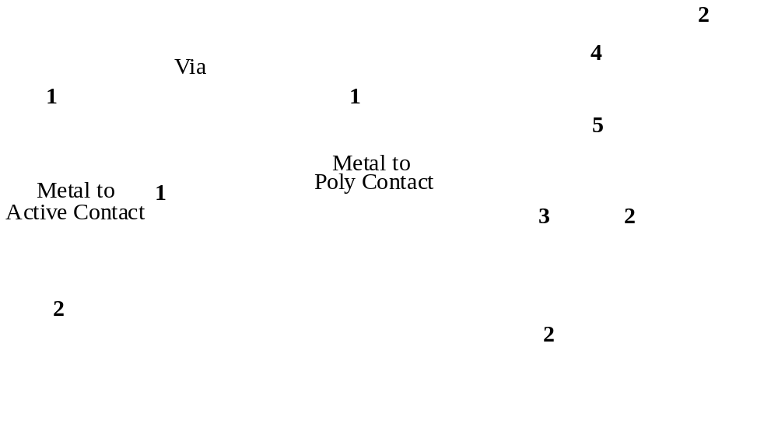
Vias and Contacts

Slide 40
Next Lecture and Reminders
Next lecture
  Static complementary CMOS gate design
    Reading assignment – Rabaey, et al, 6.1-6.2.1
Reminders
  Project Title due September 12th (next class!)
  HW2 due September 24th
  Evening midterm exam scheduled
    Wednesday, October 10th from 8:15 to 10:15pm in 260 Willard
    Only one midterm conflict filed for so far

